Slide 1
Habit 2:
Begin with the end in mind
By Timo van der Steenhoven

Slide 2
Index
- What am I doing now?
- What does Covey say?
- What is my plan?
Bonus: mission

Slide 3
What am I doing now?
Study
Life

Slide 4
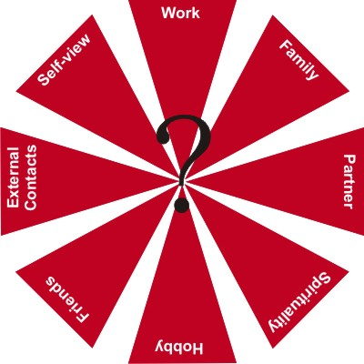
What does Covey say?
Security
Guidance
Wisdom
Power

Slide 5
What is my plan?
What did the chapter of Habit 2 do with me?
The habit is bigger than you think…

Slide 6
Bonus: mission
Personal mission statement
Www.franklincovey.com/MSB

Slide 7
Personal Mission Statement
I am at my best when I am together with people I like and I feel I can help a friend/family member out..
I will try to prevent times when I am stuck in my side of the story. .
I will enjoy my work by finding employment where I can I love to tackle difficult problems that require me to tap into different subjects and explaining how I did it to people who want to know. .
I will find enjoyment in my personal life through Keep working on my home together with my girlfriend (probably fiancee by the time I revice this mission statement). I also like to wind down after a full day of study with a videogame or a movie, to give my mind some rest..
I will find opportunities to use my natural talents and gifts such as I am a quick learner, logical and I can easily cope with new situations..
I can do anything I set my mind to. I will I would try to build a nice life for me and my wife. In the future I would give my children every education chance they need to succeed in life without pushing them to their limits, as long as they are happy doing what they do..
My life's journey is about a boy who had to became a man on his own and finding a companion allong the way to aid him in his epic battles against anxiety, stress and difficult boss fights against teachers. After the final dungeon of studies I need to step up and try to fight my way into the world that I have studied for, all while i'm raising my next-to-be-heroes with my heroine wife. After the go on their own adventures and find their own hero(ine) to aid them in their battle, the time has come for me to help other starting heroes in their adventure and learn them the tricks of the trade, while they fullfill their own potential, I'm only there to guide them and I will do so till my dying breath..

Slide 8
Mission Statement part 2
I will be a person who My wife, children, grandchildren, brother and sisters will be there. I hope we can laugh about the past with our parents and the way life has gone for us. I imagine a table for 20 people, filled with my close friends and family. I hope that table will be twice that size, but I have to start somewhere..
My most important future contribution to others will be I will do my best to help my friends/family with the knowledge I have. Nobody can know every thing, but I know that with my family and friends there is nothing I can't know..
I will stop procrastinating and start working on:
I have to step down from my point of view and let other people do the observing. I should be discussing with people, not try to convince them to see things from my point of view.
I will strive to incorporate the following attributes into my life:
For having the gift of unending love
For showing me perseverance in raising two children alone.
For being a father figure I aspire to be.
I will constantly renew myself by focusing on the four dimensions of my life:
I would like to exercise more, or at least ride my bicycle some more. It releaves mee of stress and gives me some time to think.
Having the ability to redirect the stress of an obstacle in life to a learning experience.
For me to have the confirmation that I have a group of people supporting me in my life.

